Slide 1
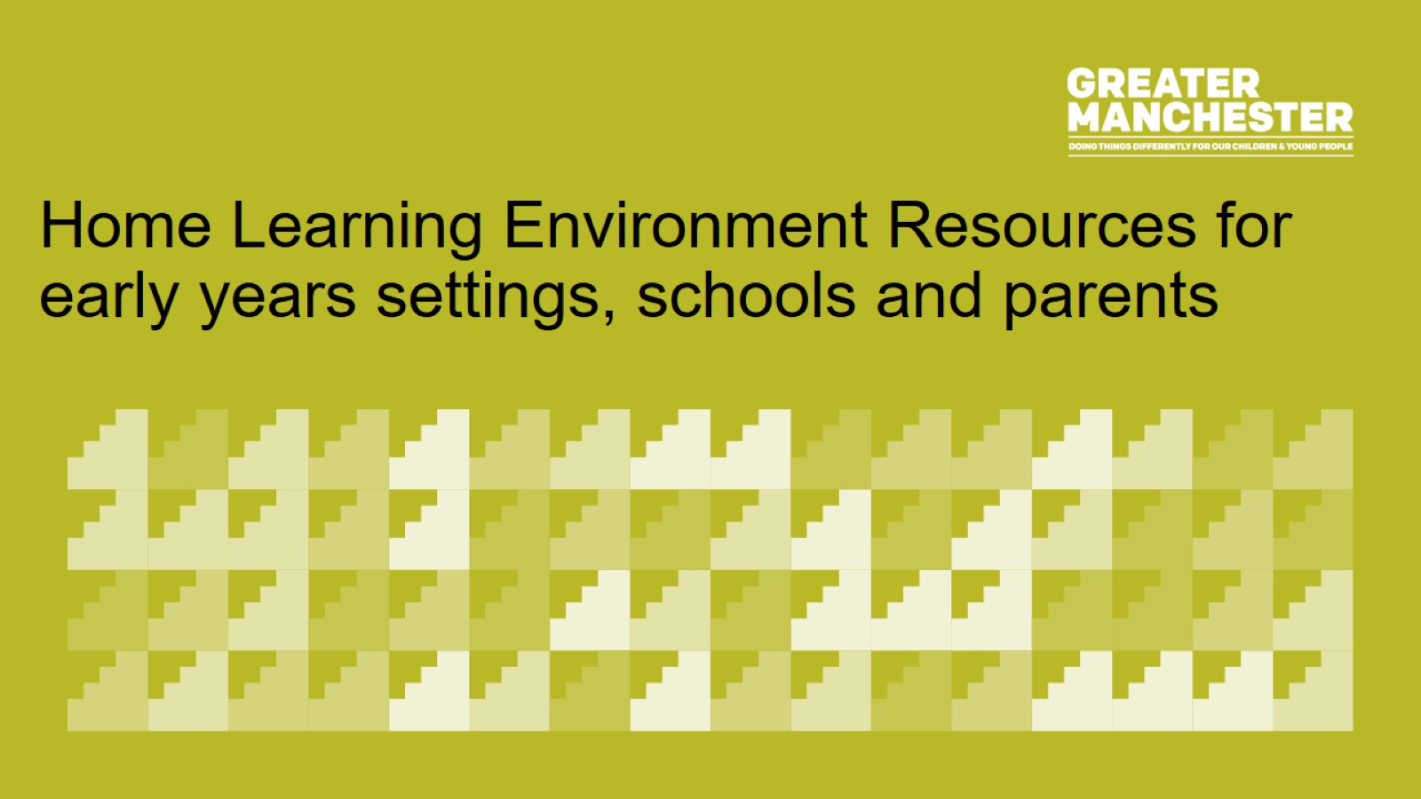
Home Learning Environment Resources for early years settings, schools and parents

Slide 2

Overview

Slide 3
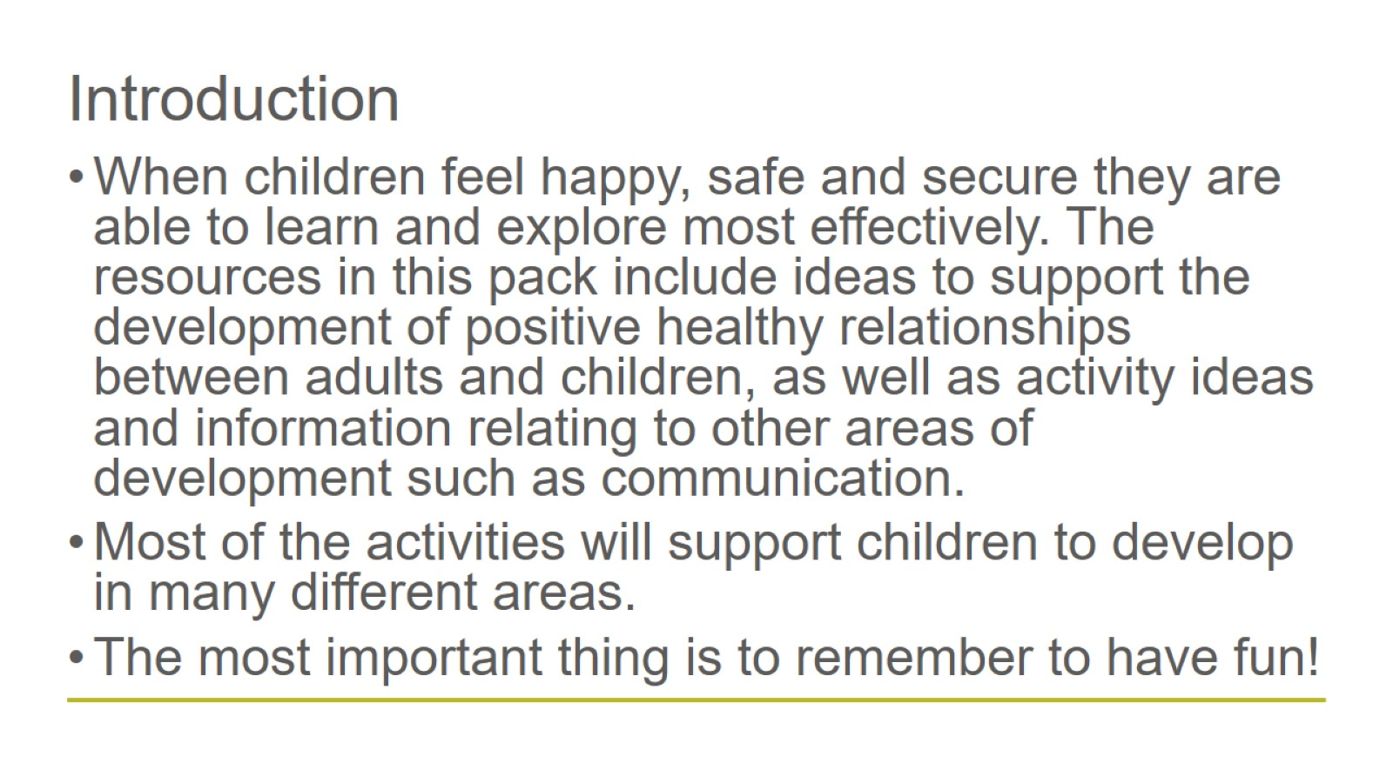
Introduction

Slide 4
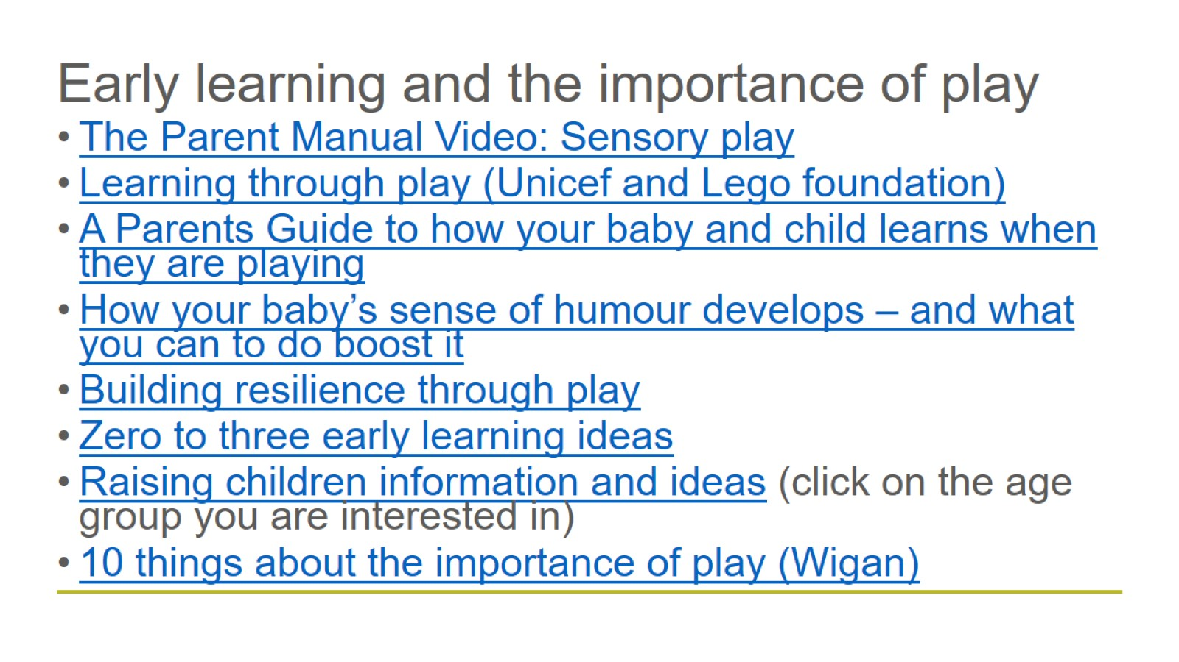
Early learning and the importance of play

Slide 5
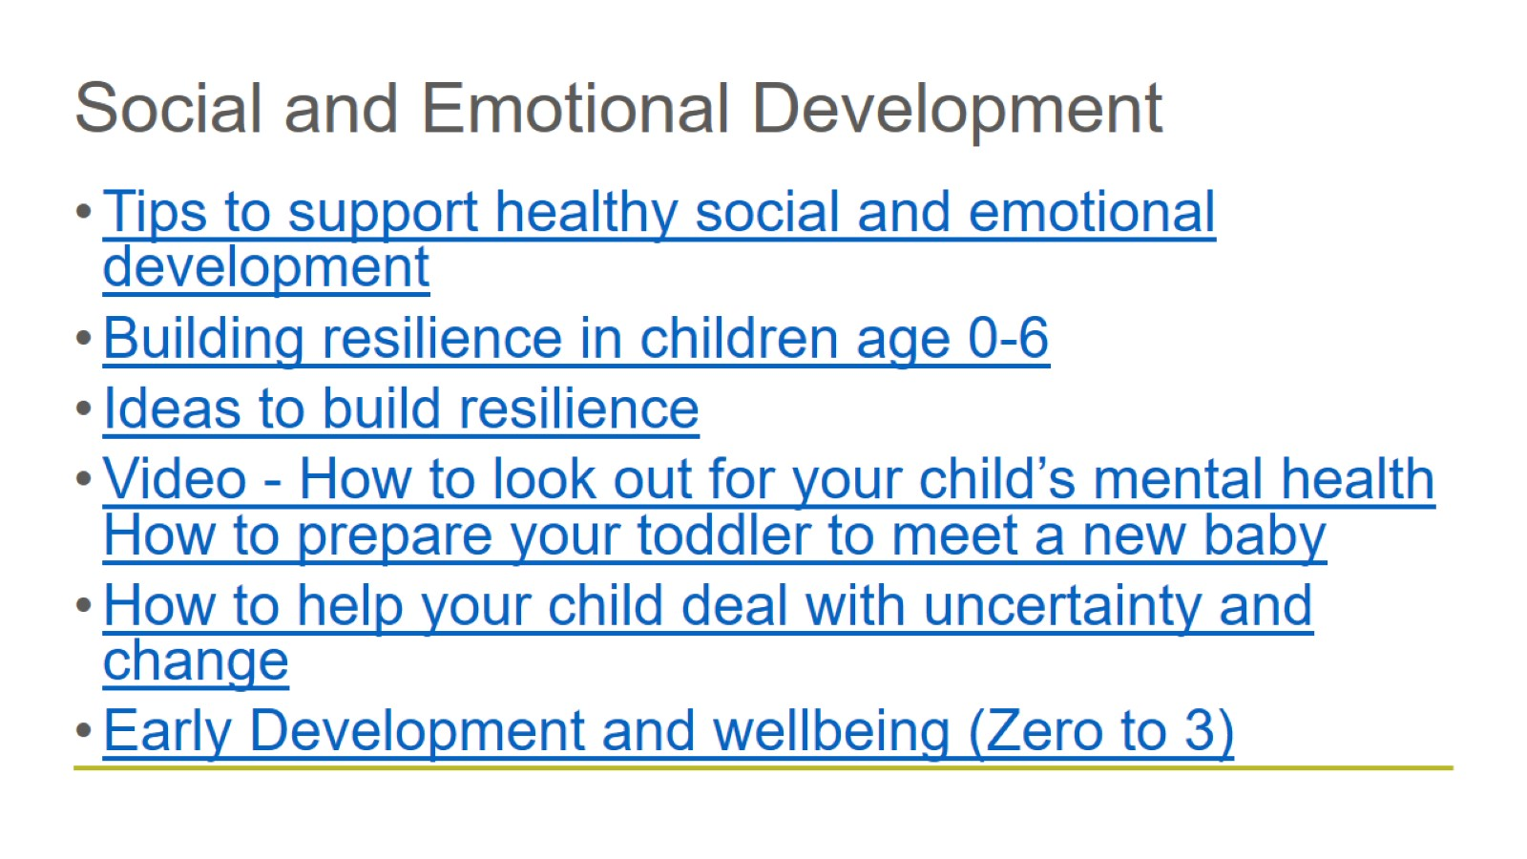
Social and Emotional Development

Slide 6
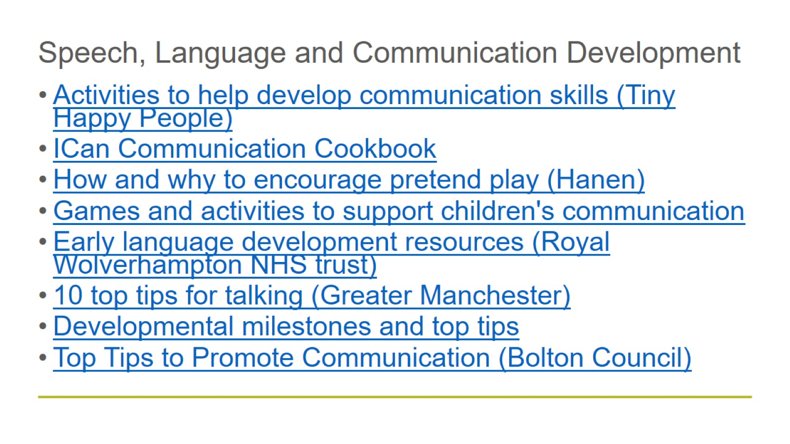
Speech, Language and Communication Development

Slide 7
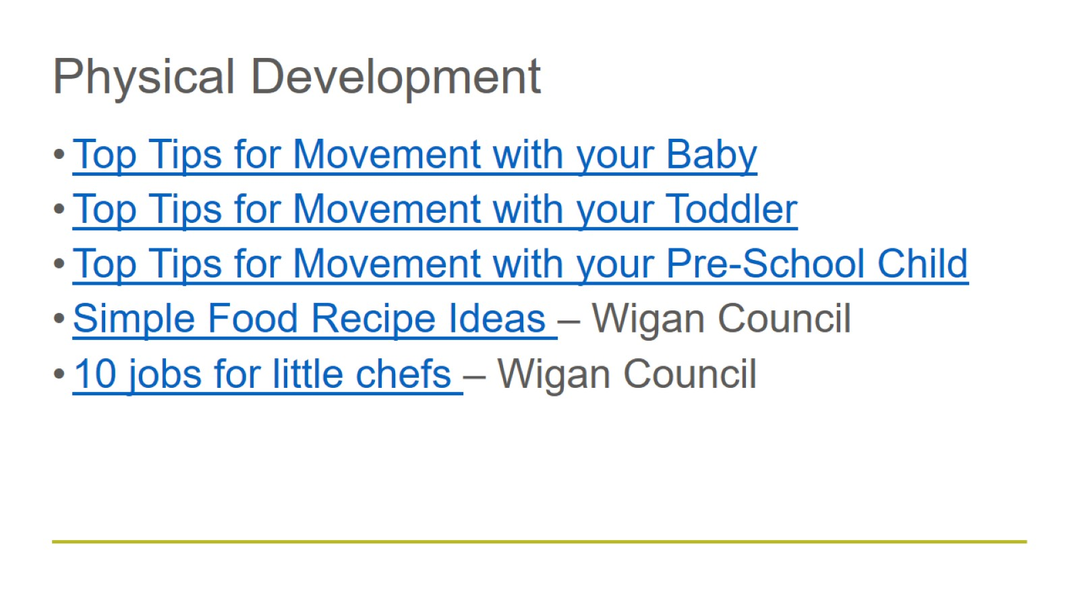
Physical Development

Slide 8
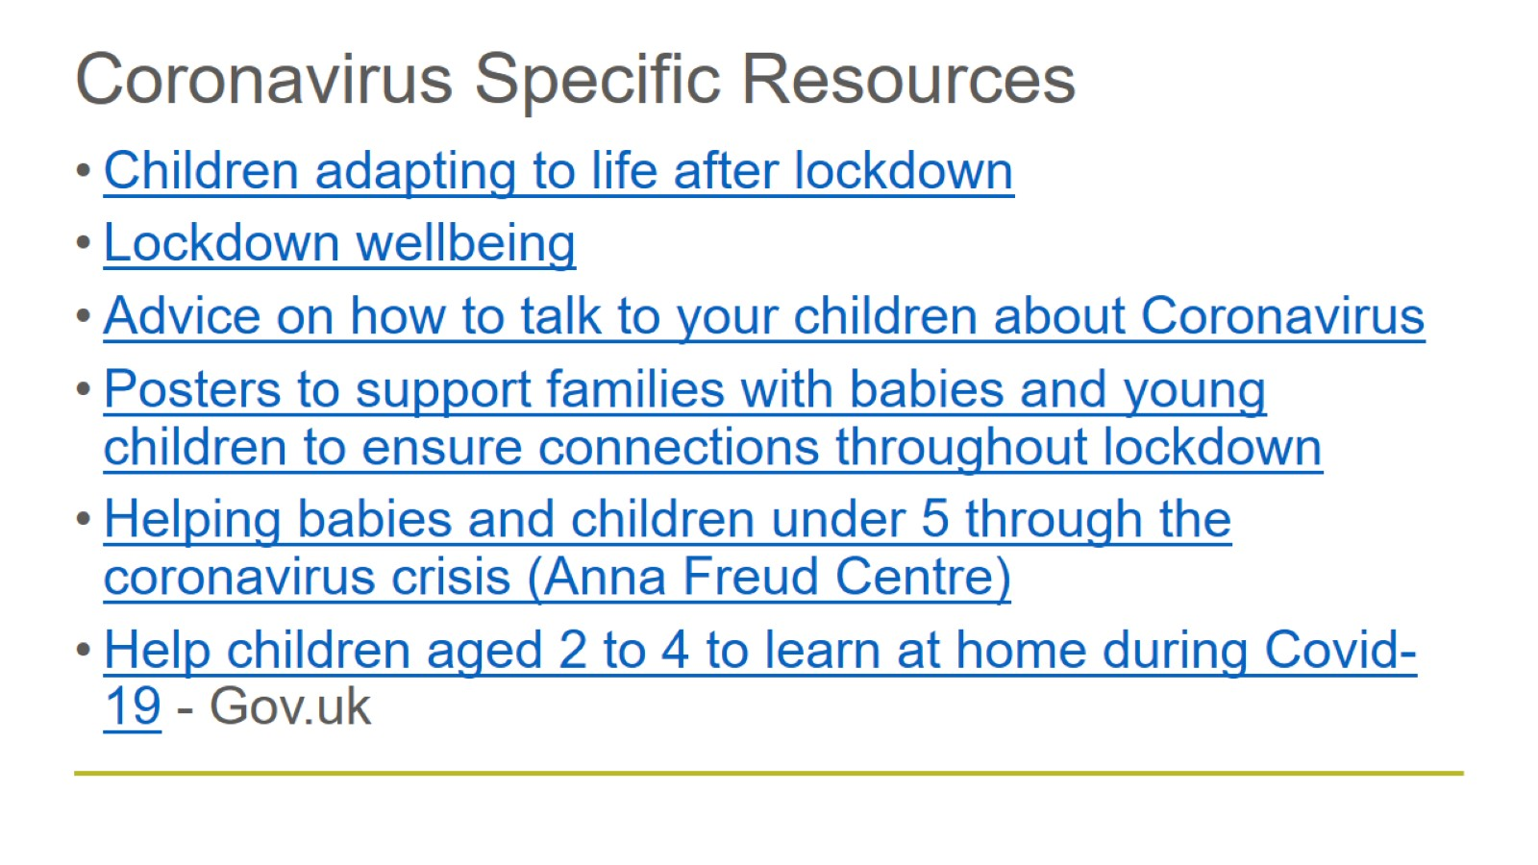
Coronavirus Specific Resources

Slide 9
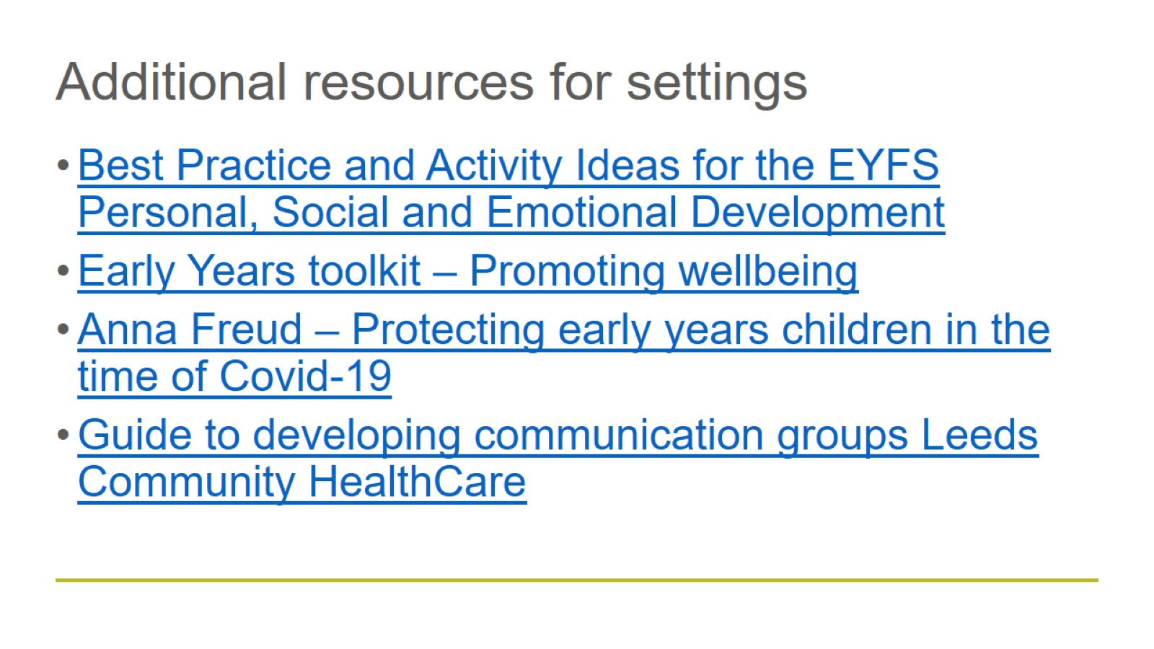
Additional resources for settings

Slide 10
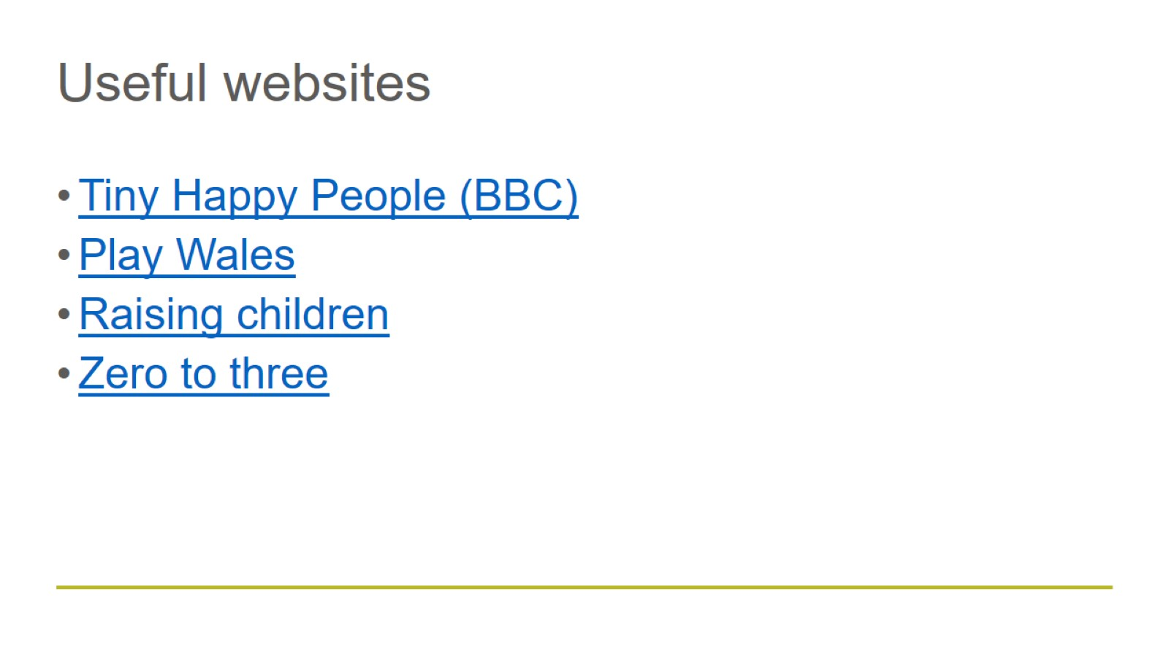
Useful websites

